Slide 1
Fences, Walls and Drinking Establishments Planning & Land Development Regulation Board Workshop May 20, 2015

Slide 2
Fences and Walls

Slide 3
Fences and Walls in Palm Coast
At their Jan. 13th meeting, City Council requested Planning staff to review our fencing and wall standards.
With a focus on whether fences along saltwater canals should be open or reduced in height as they approached the canals.
Staff reviewed these standards and made presentations to City Council at their March 10 and March 31 workshops.

Slide 4
Palm Coast’s Fence and Wall History
A Palm Coast Community Service Corporation policy in January 1996 had the following guidelines:
Black chain link fences were the preferred fencing material along saltwater canal lots.
Maximum fence height was 6 feet.
Fences and walls over 3 feet in height required review by the Architectural Review Committee.
Those in front yards over 3 feet high were only allowed as variances.

Slide 5
Review of Current Standards
Palm Coast’s Land Development Code has the following fence and wall standards:

Slide 6
Current One & Two-Family Standards
Not Allowed in Front Yards Except in
Neo-Traditional Developments

Slide 7
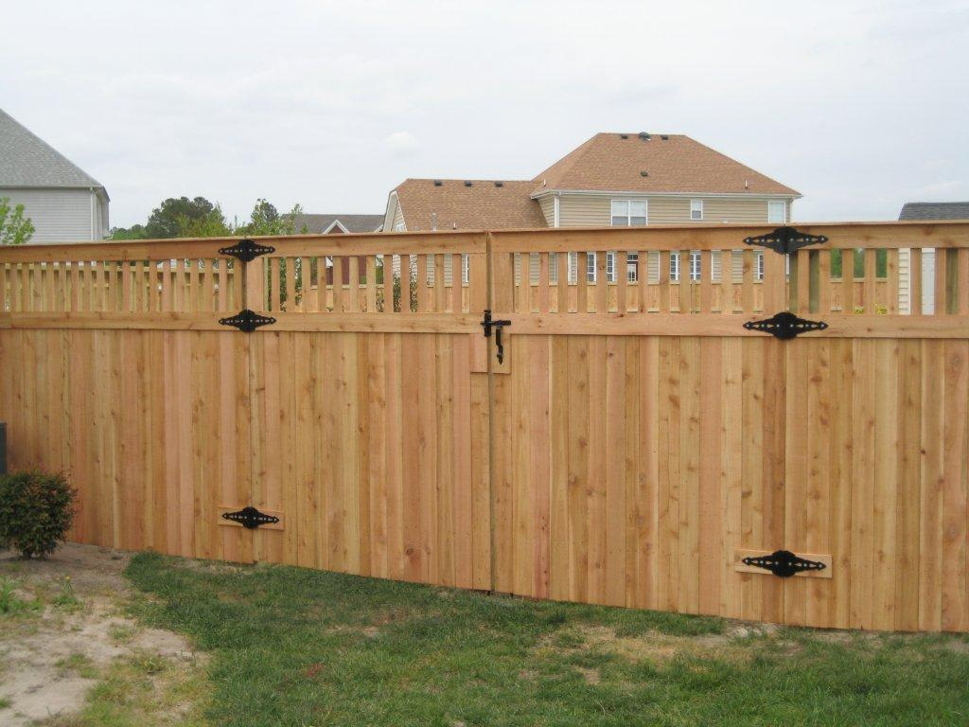
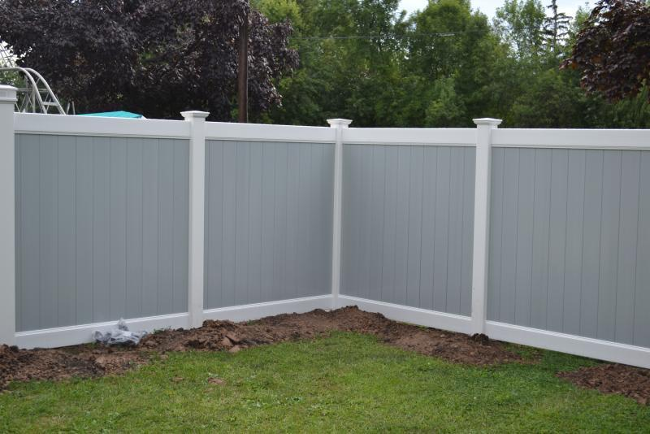
Current One & Two-Family Standards
Maximum height of 6 feet

Slide 8
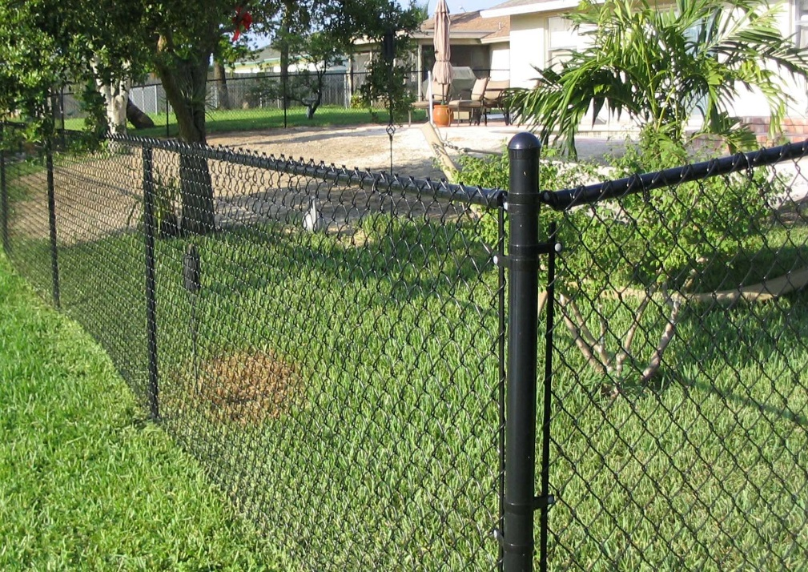
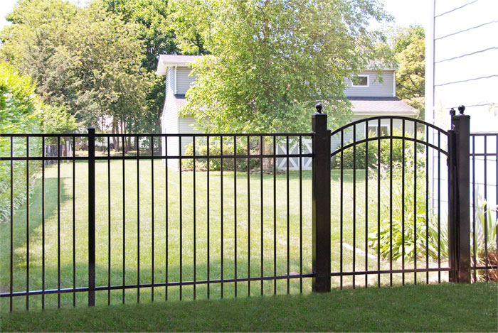
Current One & Two-Family Standards
Metal fences must be black or may be bronze when the home has a bronze screen room

Slide 9
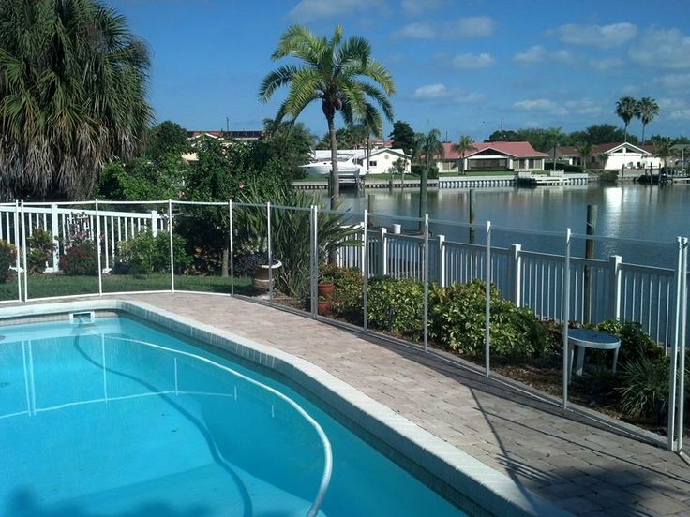
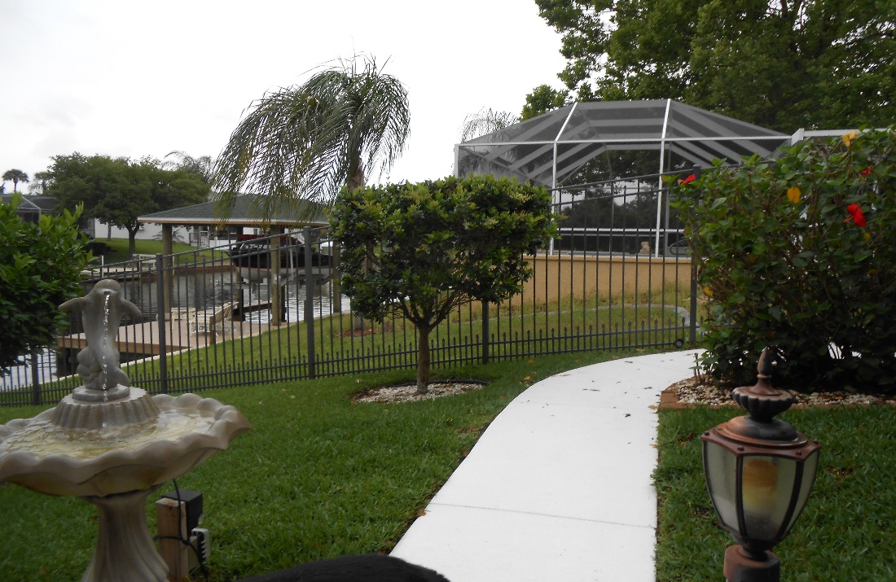
Current One & Two-Family Standards
No requirement to reduce solid fence heights or
have them open nearby saltwater canals

Slide 10
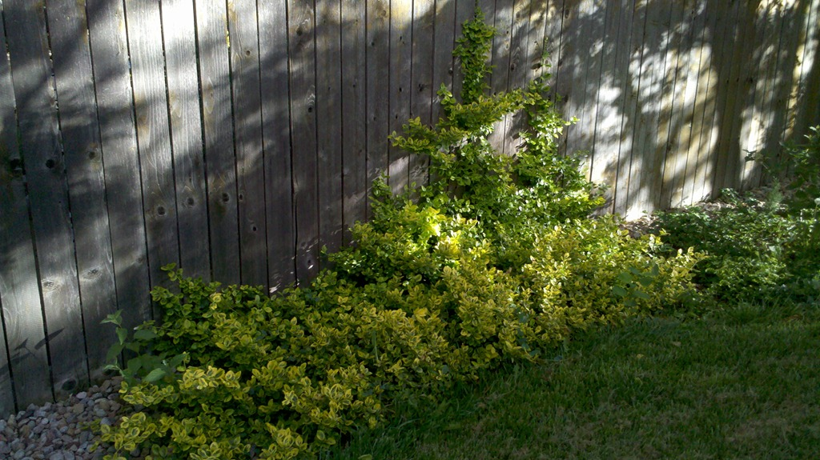
Current One & Two-Family Standards
On rear property lines along saltwater canals, golf courses, and rights-of-way; fences must be setback 3 feet for required plantings outside of the fence.

Slide 11
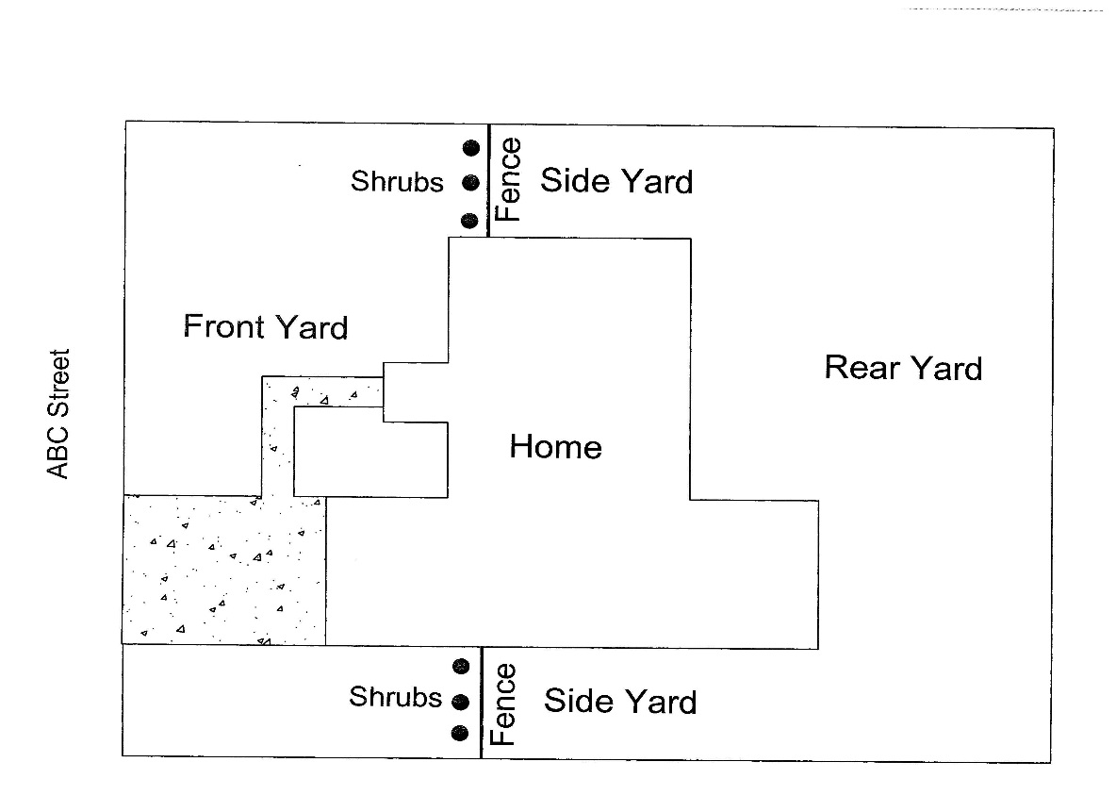
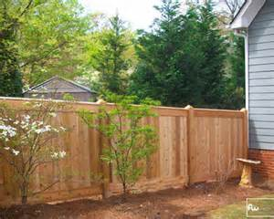
Current One & Two-Family Standards
Plantings are required in front of fences that face a street (from house to side property line).

Slide 12
City Council Workshop Results
City Council reviewed the following items and directed staff to prepare an ordinance making the initial changes with further review and recommendation by the Planning Board.

Slide 13
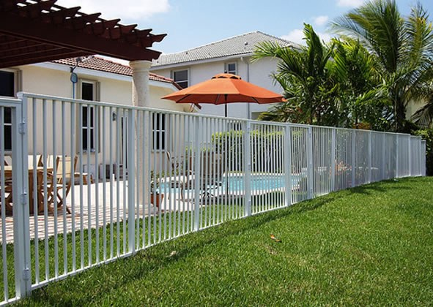
Allow White Aluminum and Bronze Metal Fences

Slide 14
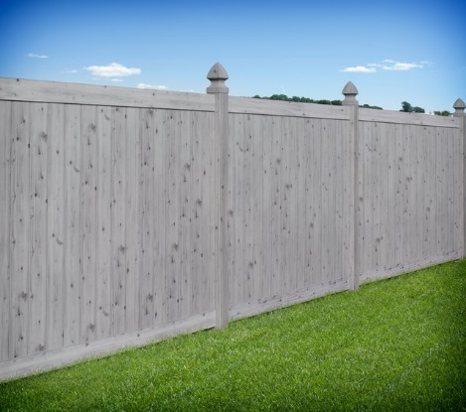
For Vinyl Fences Allow a Variety of Colors and Simulated Wood-Grain

Slide 15
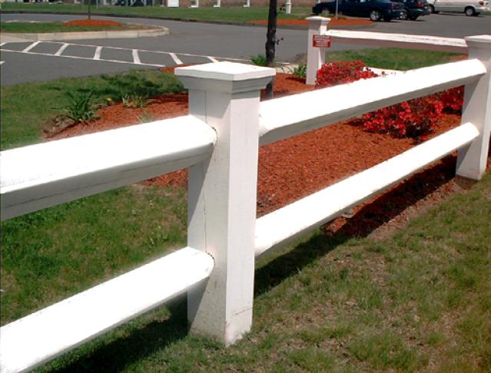
Possibly Allow Short, Open Fences Along the sides of Front Yards

Slide 16
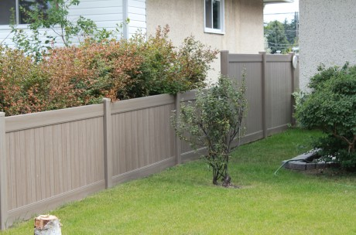
Require Solid Fences to Reduce Height to 4’ Within 20’ of Saltwater Canals

Slide 17
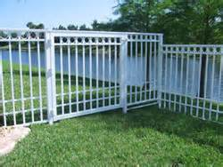
Or Require Fences to be Open Within 20 Feet of Saltwater Canals

Slide 18
Stop Requiring Fences to be Set Back 3 Feet From Canals, Golf Courses and ROWs for Required Planting Areas

Slide 19
Discontinue Requiring Shrubs along Fences Facing Streets

Slide 20
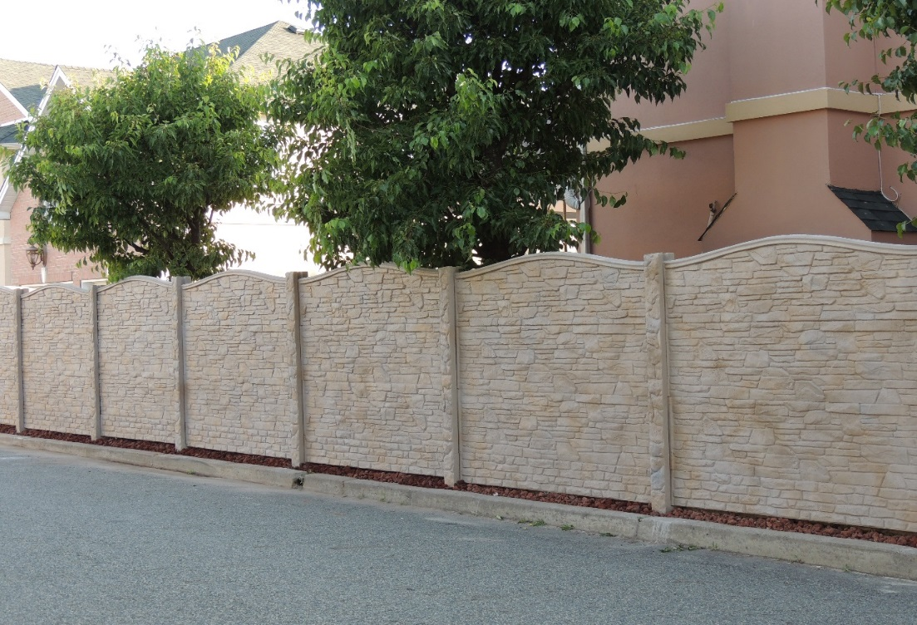
Allow Pre-Cast Concrete Fences in Wood-Grain, Stone or Brick Patterns

Slide 21
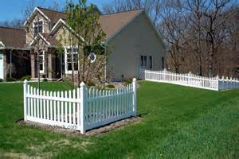
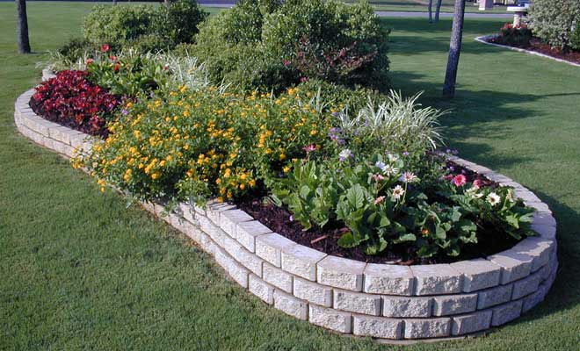
Planning staff suggests only allowing fences and walls as landscape features in front yards

Slide 23
Summary of Potential Changes
Allow more colors for metal & vinyl fences
Within 20 feet of saltwater canals require fences to be open or reduced in height to 4 feet
Stop requiring fences to be setback 3 feet from canals, golf courses and ROWs and discontinue requiring the adjacent planting areas
Discontinue requiring shrubs along fences facing a street
Allow pre-cast fences
Consider allowing short open fences in front yards

Slide 24
Drinking Establishments

Slide 25
City Council Review/Direction
The City Council also requested Planning staff to review the standards for drinking establish-ments when they asked staff to look at the fence and wall standards.

Slide 26
Types of Drinking Establishments
Palm Coast has two levels of drinking establishments that are split by their intensity.
Bars, taverns and nightclubs (without discotheques and/or live entertainment) are the lower intensity ones.
Bars, taverns and nightclubs (with discotheques and/or live entertainment) are the higher intensity ones.

Slide 27
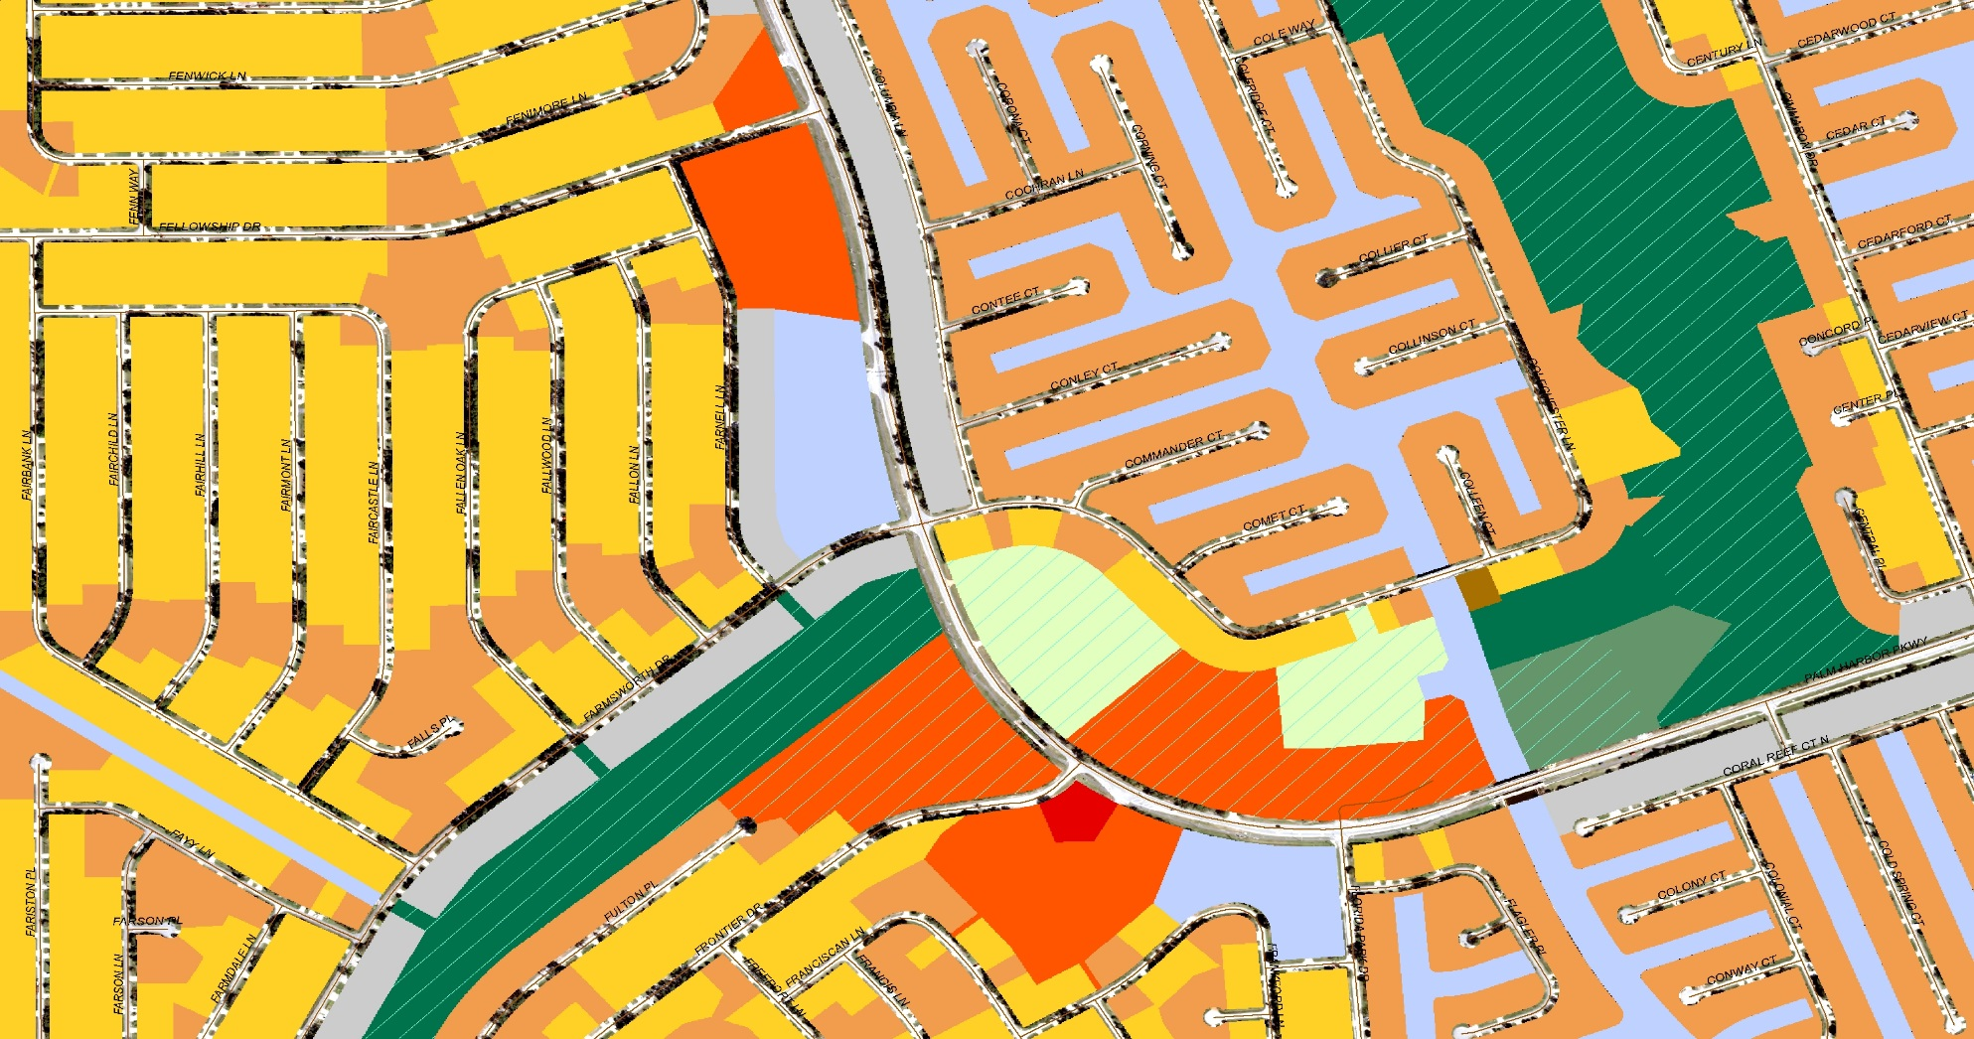
Lower Intensity Bars and Zoning
Permitted in COM / Special Exception in OFC

Slide 28
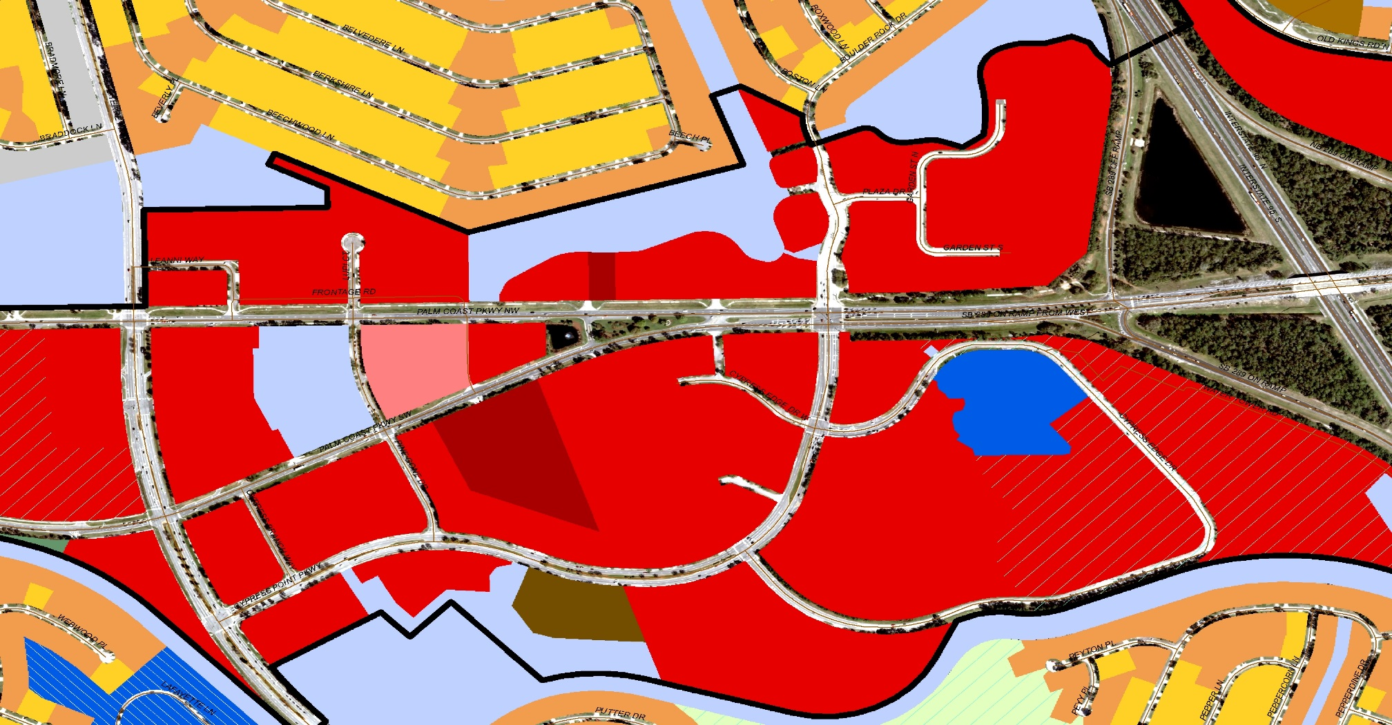
Higher Intensity Bars and Zoning
Permitted in COM-3 / Special Exception in COM-2

Slide 29
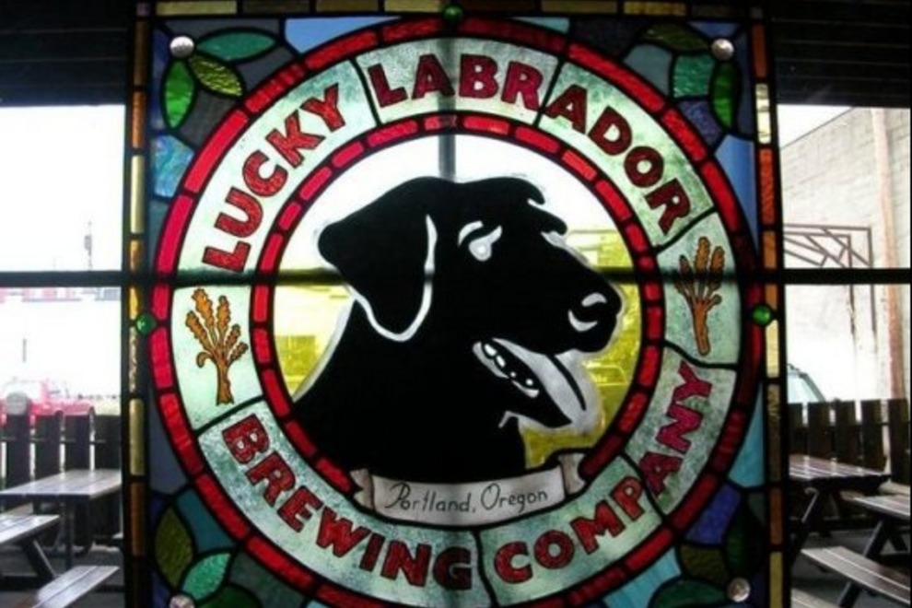
Brew Pubs and Micro-Breweries are an Evolving Trend

Slide 30
City Council’s Initial Directions on Drinking Establishments
Modify our land use standards so bars, taverns and nightclubs are not allowed in the OFC and COM-1 Districts.
Modify our thresholds from discotheques and live entertain-ment to outdoor entertainment. (Bars with outdoor entertainment typically have the most impact on any neighboring homes.)
Update our terminology on drinking and eating establish-ments in order to improve the clarity and breakdown of uses in Table 3-4.

Slide 31
Fences, Walls and Drinking Establishments Planning & Land Development Regulation Board Workshop May 20, 2015

